Slide 1
Mini-Project
Mid-sem -01

Slide 2
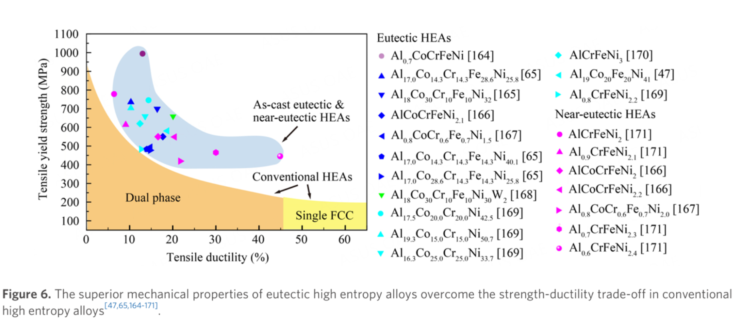

Slide 4
Mini-Projet
Mid-sem -02

Slide 5
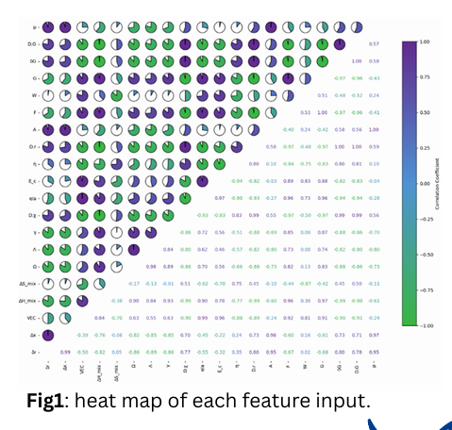
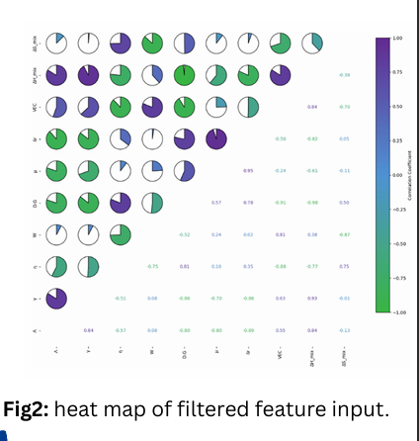
Selection of Parameters
Left Plot — All Features (Before Selection)
The left correlation matrix includes all the initial material descriptors or thermodynamic parameters considered in the dataset — parameters like μ,D.G.,W,η,VEC,ΔHmix​,ΔSmix​ etc.
Here, many circles are deep purple or green, and many cells show correlation values close to ±1.
→ This means many of these features are strongly correlated with each other.
Right Plot — Reduced Feature Set (After Selection)
The right correlation matrix shows only the 10 selected features that were chosen for ML modeling.
Notice that the pie charts here are mostly:
  Smaller fills (weak correlations),
  Colors near white or light shades (values closer to 0).

